Slide 1
Chemical Equilibrium
Prof. Dr. Md. Hafezur Rahaman
Dept. of Applied Chemistry and Chemical Engineering
Islamic University, Kushtia 7003, Bangladesh

Slide 2
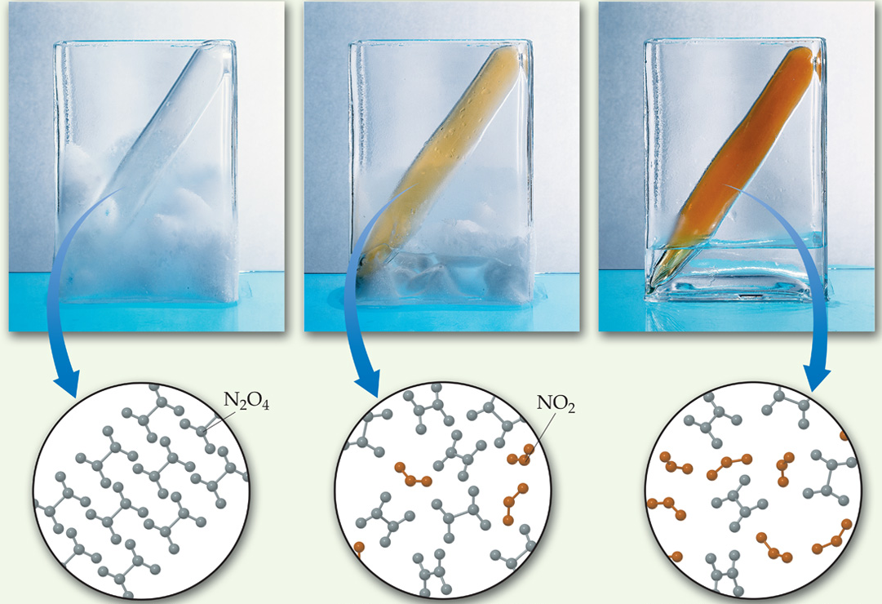
The Concept of Equilibrium
Chemical equilibrium occurs when a reaction and its reverse reaction proceed at the same rate.

Slide 3
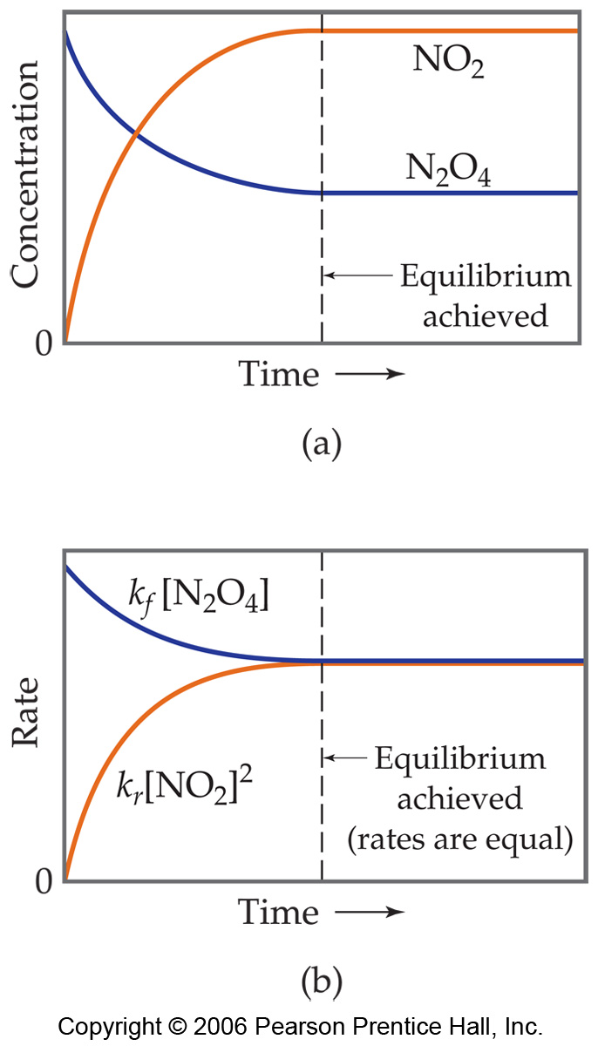

The Concept of Equilibrium
As a system approaches equilibrium, both the forward and reverse reactions are occurring.
At equilibrium, the forward and reverse reactions are proceeding at the same rate.

Slide 4
A System at Equilibrium
Once equilibrium is achieved, the amount of each reactant and product remains constant.

Slide 5
A System at Equilibrium
Rates become equal
Concentrations become constant

Slide 6

Depicting Equilibrium
In a system at equilibrium, both the forward and reverse reactions are running simultaneously. We write the chemical equation with a double arrow:

Slide 7
The Equilibrium Constant

Slide 8

The Equilibrium Constant
Reverse reaction:
Forward reaction:

Slide 9

The Equilibrium Constant
The ratio of the rate constants is a constant (as long as T is constant).
The expression becomes

Slide 10

The Equilibrium Constant
To generalize, the reaction:
Has the equilibrium expression:
This expression is true even if you don’t know the elementary reaction mechanism.

Slide 11
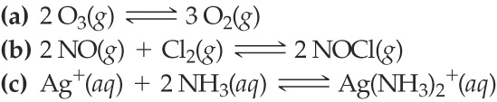
SAMPLE EXERCISE 15.1 Writing Equilibrium-Constant Expressions
Write the equilibrium expression for K_{c} for the following reactions:

Slide 12
PRS here…

Slide 13



SAMPLE EXERCISE 15.1 Writing Equilibrium-Constant Expressions
Write the equilibrium expression for K_{c} for the following reactions:
PRACTICE EXERCISE
Write the equilibrium-constant expression, K_{c} for

Slide 14
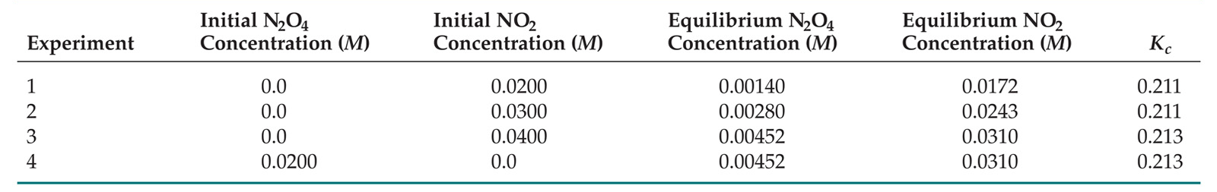

Equilibrium Can Be Reached from Either Direction
K_{c}, the final ratio of [NO₂]² to [N₂O₄], reaches a constant no matter what the initial concentrations of NO₂ and N₂O₄ are (with const T).

Slide 15
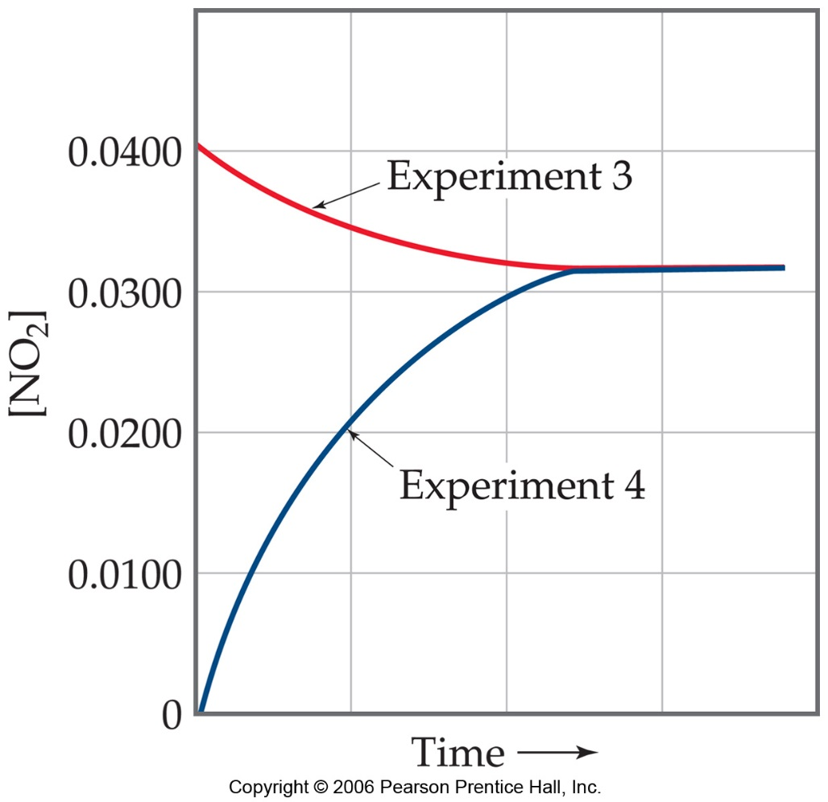

Equilibrium Can Be Reached from Either Direction
This graph shows data from the last two trials from the table.

Slide 16

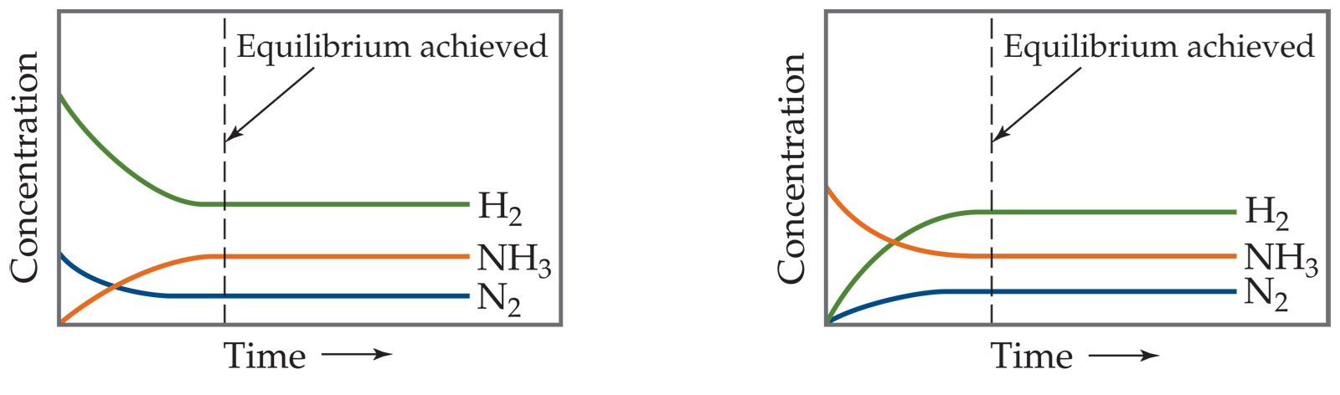
Equilibrium Can Be Reached from Either Direction
It does not matter whether we start with N₂ and H₂ or whether we start with NH₃. We will have the same proportions of all three substances at equilibrium.
What is the equilibrium expression?

Slide 17
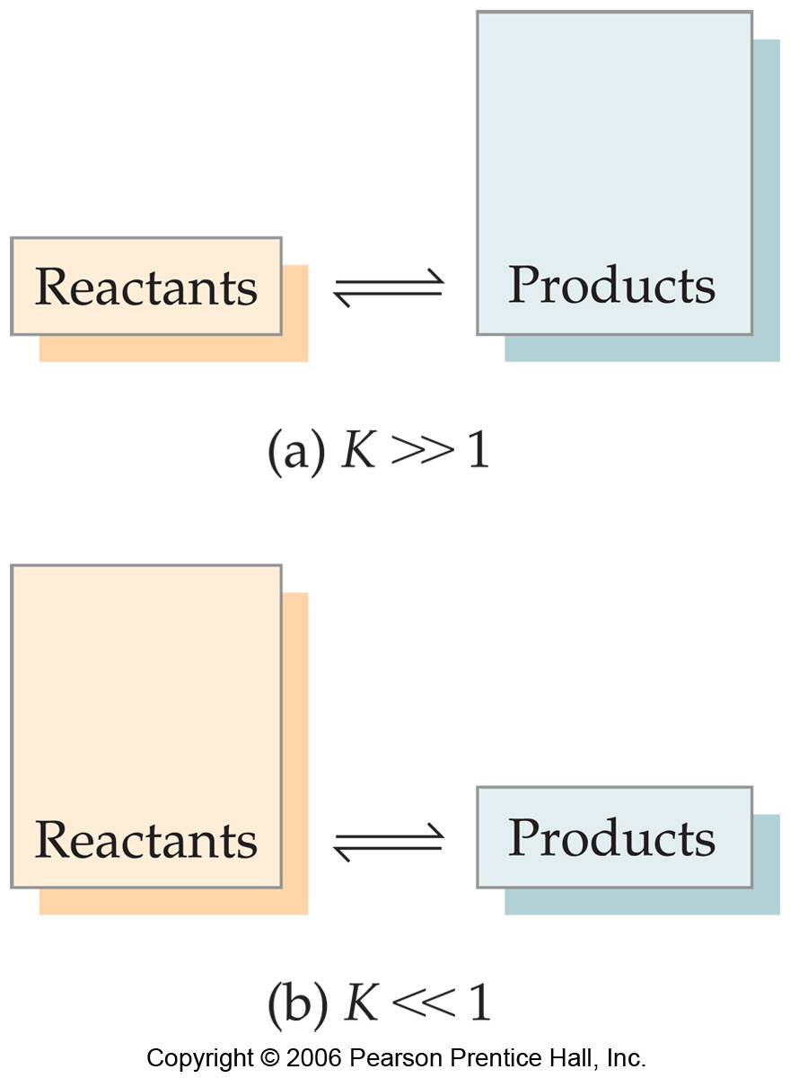
What Does the Value of K Mean?
If K >> 1, the reaction is product-favored; product predominates at equilibrium.

Slide 18
What Does the Value of K Mean?
If K >> 1, the reaction is product-favored; product predominates at equilibrium.
If K << 1, the reaction is reactant-favored; reactant predominates at equilibrium.

Slide 19




Manipulating Equilibrium Constants
The equilibrium constant of a reaction in the reverse reaction is the reciprocal of the equilibrium constant of the forward reaction.

Slide 20
Manipulating Equilibrium Constants
The equilibrium constant for a net reaction made up of two or more steps can be found from the equilibrium constants for the individual steps.`
At 1565 K we have these equilibrium constants:
ans=2.9

Slide 21
Equilibrium Calculations

Slide 22
Le Châtelier’s Principle

Slide 23
Le Châtelier’s Principle
“If a system at equilibrium is disturbed by a change in temperature, pressure, or the concentration of one of the components, the system will shift its equilibrium position so as to counteract the effect of the disturbance.”
Systems shift from “Q” towards “K”.

Slide 24
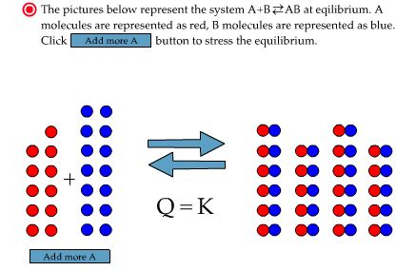
What Happens When More of a Reactant Is Added to a System?

Slide 25
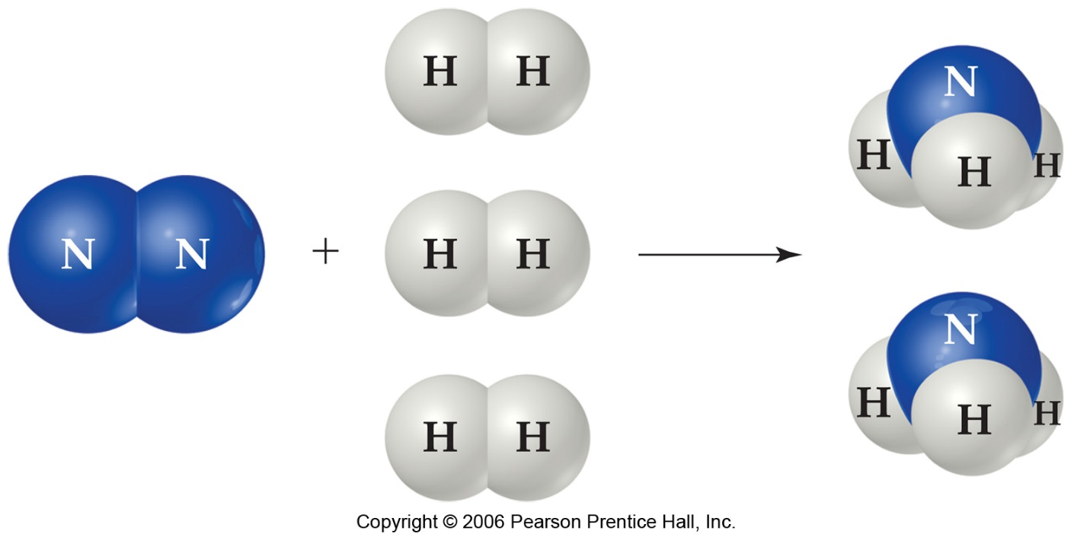
The Haber Process
The transformation of nitrogen and hydrogen into ammonia (NH₃) is of tremendous significance in agriculture, where ammonia-based fertilizers are of utmost importance.

Slide 26

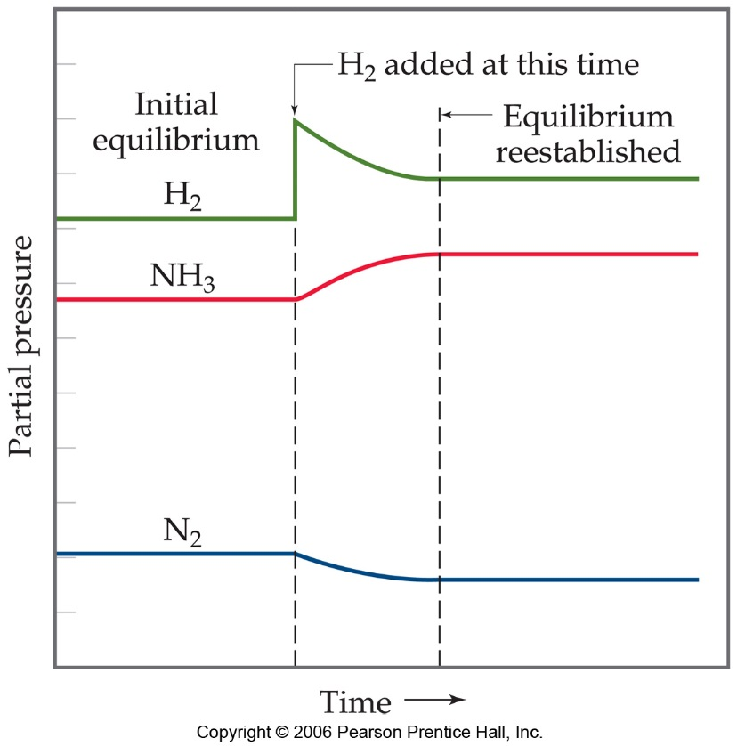
The Haber Process
If H₂ is added to the system, N₂ will be consumed and the two reagents will form more NH₃.

Slide 27
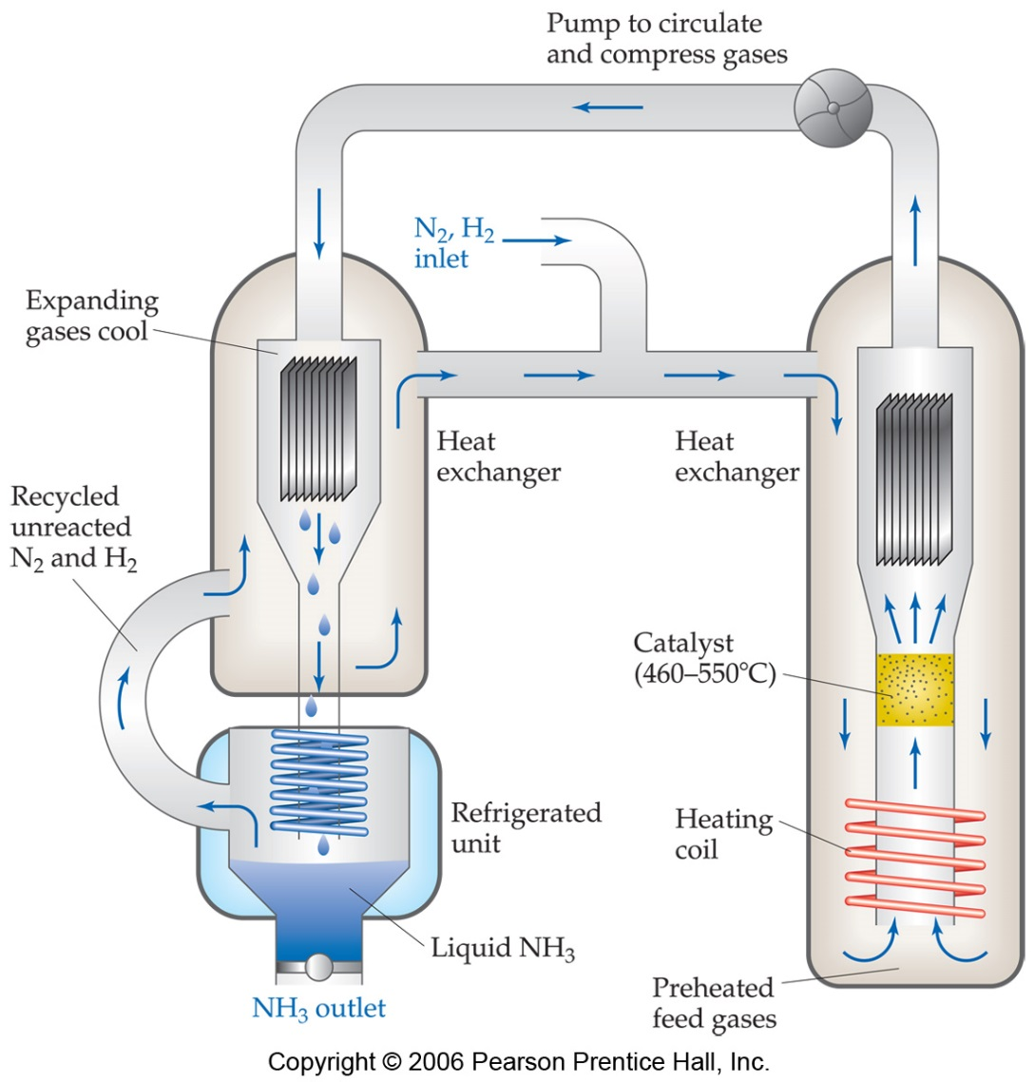
The Haber Process
This apparatus helps push the equilibrium to the right by removing the ammonia (NH₃) from the system as a liquid.

